Slide 1
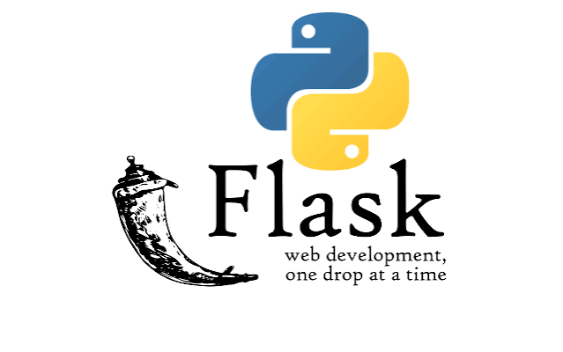

Slide 2
Flask is a lightweight web framework for Python used to build web applications, REST APIs, and backend services.
It is called a micro-framework because it provides the essential features for web development without forcing a particular project structure or including many built-in components.
Some important features of Flask are:
Simple and lightweight
Easy to learn for Python programmers
Supports URL routing
Can create REST APIs
Supports HTML templates using Jinja2
Supports handling GET, POST, PUT, DELETE requests
Can connect to databases
Useful for prototypes as well as production web applications

Slide 3
Core Pillars of the Microframework
Flask's minimal core relies primarily on two key dependencies:
Werkzeug: A WSGI (Web Server Gateway Interface) toolkit used to properly handle HTTP requests, responses, and routing.
Jinja: A powerful template engine used to generate dynamic HTML content.
Key Benefits
No Unnecessary Bloat: It does not come with a default ORM (Object-Relational Mapper) or form validation layer. You only add what your specific project needs.
Maximum Flexibility: You can swap out components effortlessly, making it highly adaptable for everything from simple APIs to serving machine learning models.
Quick Setup: You can write and run a minimal, functional web application in a single Python file.

Slide 4
Create a file called:
app.py
  from flask import Flask
  app = Flask(__name__)
  @app.route("/")
  def home():
  return "Hello, World!"
  if __name__ == "__main__":
  app.run(debug=True)
Run it:
python app.py
/////__name__ tells Flask where the application is located so that it can find resources such as templates and static files.
if __name__ == "__main__":
app.run(debug=True)
This starts Flask's development server when you execute app.py directly.
debug=True enables useful development features such as automatic reloading and detailed error pages. It should not be used as the production deployment configuration.

Slide 5
Flask Routing
One of Flask's most important features is routing. We can create multiple URLs:
  @app.route("/")
  def home():
  return "Home Page"
  @app.route("/about")
  def about():
  return "About Page"
  @app.route("/contact")
  def contact():
  return "Contact Page"

Slide 6
Dynamic URLs
Flask can also accept values from URLs.
For example:
@app.route("/user/<name>")
def user(name):
return f"Hello {name}!"

Slide 7
HTTP Methods
Web applications commonly use HTTP methods such as:
GET, POST, PUT, DELETE
By default, a Flask route handles GET.
For example:
@app.route("/hello", methods=["GET"])
def hello():
return "Hello"
A POST request can be handled using:
@app.route("/login", methods=["POST"])
def login():
return "Login request received"
Multiple methods can also be specified:
@app.route("/user", methods=["GET", "POST"])
def user():
return "User endpoint"

Slide 8
Flask for REST APIs
Flask is commonly used to create APIs.
For example:
from flask import Flask, jsonify
app = Flask(__name__)
@app.route("/api/student")
def student():
return jsonify({
"name": "Hari ",
"course": "Computer Science",
"subject": "Python"
})
if __name__ == "__main__":
app.run(debug=True)
//// jsonify is a Flask function used to convert Python data into a JSON HTTP response.

Slide 9
Request:
GET /api/student
Response:
{
"name": "Hari",
"course": "Computer Science",
"subject": "Python"
}
This is particularly useful when a Python backend needs to communicate with:
Web applications
Mobile applications
IoT devices
Machine-learning systems
Other servers

Slide 10
Flask in an IoT/ML Example
Suppose we have a machine-learning model that predicts whether sensor data indicates stress.
A Flask server could provide an API:
@app.route("/predict", methods=["POST"])
def predict():
data = request.get_json()
# Process sensor data
# model prediction
return jsonify({
"prediction": "stress"
})
////// request.get_json() extracts the JSON body

Slide 11
The IoT device could send: (JSON)
{
"heart_rate": 95,
"eda": 0.42,
"temperature": 32.1
}
and Flask could return:
{
"prediction": "stress"
}
This is one reason Flask is useful in IoT, machine learning etc.

